Slide 1


Docker to the rescue
The teams struggle to find a solution and when a smart member of one of the teams has an excellent idea
Introduction

Slide 2
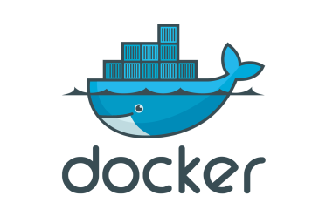
Docker to the Rescue
Container 1
JDK 1.7
Tomcat 7
Container 2
JDK 1.8
Tomcat 8
Host Operating System (Windows, MAC OSX, Linux)
Docker Engine
Infrastructure / Server
Introduction

Slide 3
Docker Quick Intro
How does Docker really help?
Docker Engine as you saw in the previous slide, allows you to run different containers. Now, imagine containers are as good a new Virtual PC with its own processing ability, memory and volumes. Isn’t this cool?
Pretend as if you are running a PC inside another a PC. Now we call the PC which is running the container the “HOST” and the PC which is run by the Docker engine as “CONTAINER”.
Introduction

Slide 4
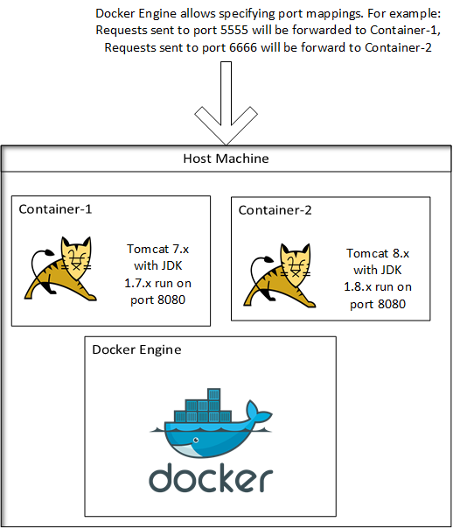
Team A: Developers, develop their apps on top of
Docker on a MAC OS X System using JDK 1.7
And Tomcat 7
Team B: Gets to use JDK 1.8 and Tomcat 8
QA: QA is happy as they get to test
An application developed using the same
Operating system. So what they test is
What it was developed on.
Dev Ops: Gets to run the apps of both teams
On the same infrastructure, with different
Memory requirements and different JVMs.
Management: Happy coz there is less expense,
Less effort and faster deployment.
Introduction

Slide 5


Docker Quick Intro
Docker for DEVOPS is like MAVEN for Java. It allows for update of packages
And software installations easily.
Introduction

Slide 6
Docker Quick Intro - Summary
Simple and easily Configurable.
Easy to Develop on.
Faster Release Cycles.
Faster Deployment Times.
Reduced bloat as compared to other virtualization techniques.
Consistent development of software across all environments.
Introduction

